Slide 1
Software Testing for Debugging
BY:
R.DILIP KUMAR
192011064

Slide 2

AIM
To analyse E-commerce application for amazon to purchasing model & delivery model.

Slide 3
E-COMMERCE Amazon Business Model
To purchase product on Amazon
Sign in to your Amazon account.
Hover over Departments and click on a category. When you find an item you want, click on it.
Review the item, and click Add to Cart.
Click Proceed to Checkout.
Enter a shipping address and click Continue.
Choose a payment method and click Continue.
Click Place Your Order.

Slide 4
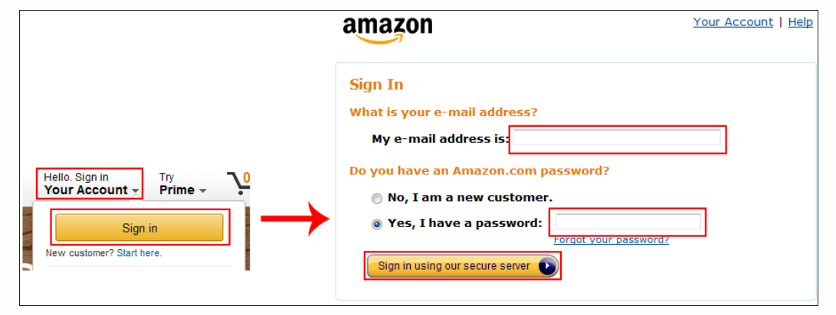
Detailed Instructions on how to buy on Amazon
1. Sign into your Amazon account.
Go to www.amazon.com in your web browser and log in. To do this, move your mouse over “Hello, Sign In” and click Sign In. Then click in the boxes highlighted in the right screenshot below and type in your email address and account password, respectively. Finally, click Sign In Using Our Secure Server.

Slide 5
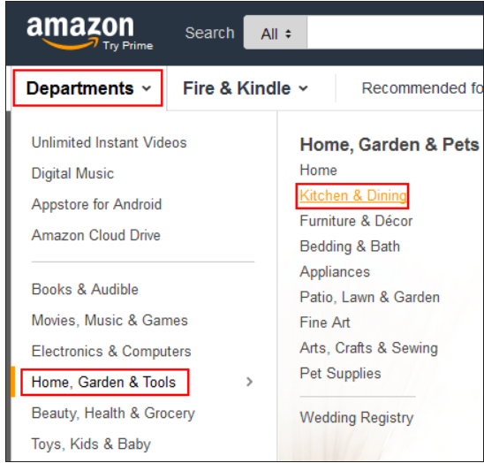
2. Search through departments.
Let’s say that your toaster just went on the fritz, and you’re looking for a new one. Let’s start by moving the mouse over Departments, then Home, Garden, and Tools, and then clicking Kitchen and Dining.

Slide 6
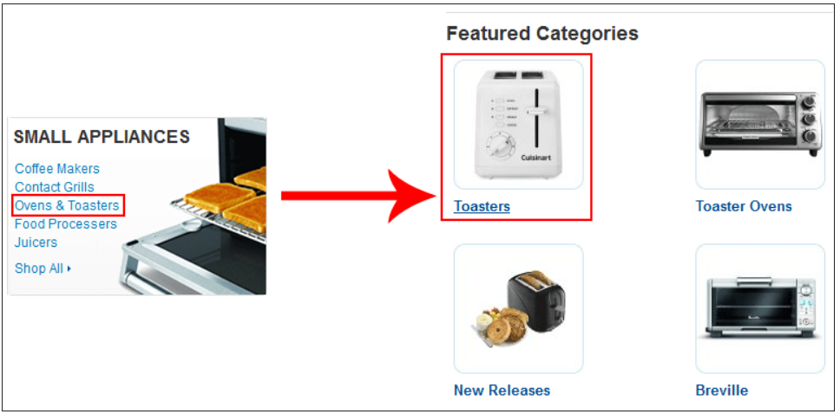
3. Find a specific category
Now, let’s click on Ovens and Toasters, and then click Toasters, just to narrow things down a bit more.

Slide 7
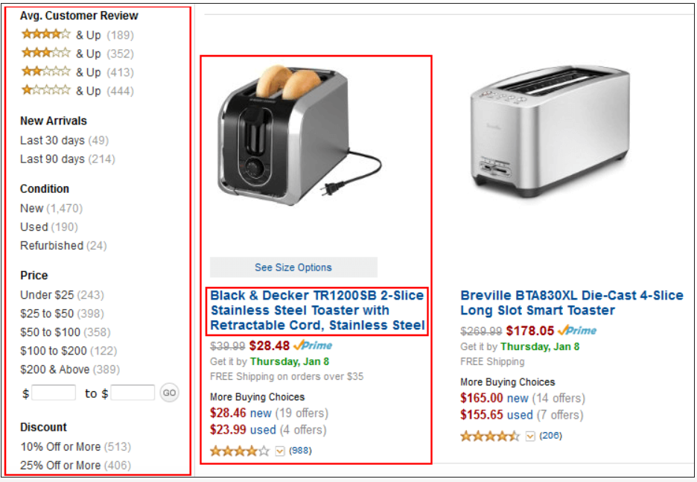
4. View and select an item.
You’ll now see a list of toasters available for sale.

Slide 8
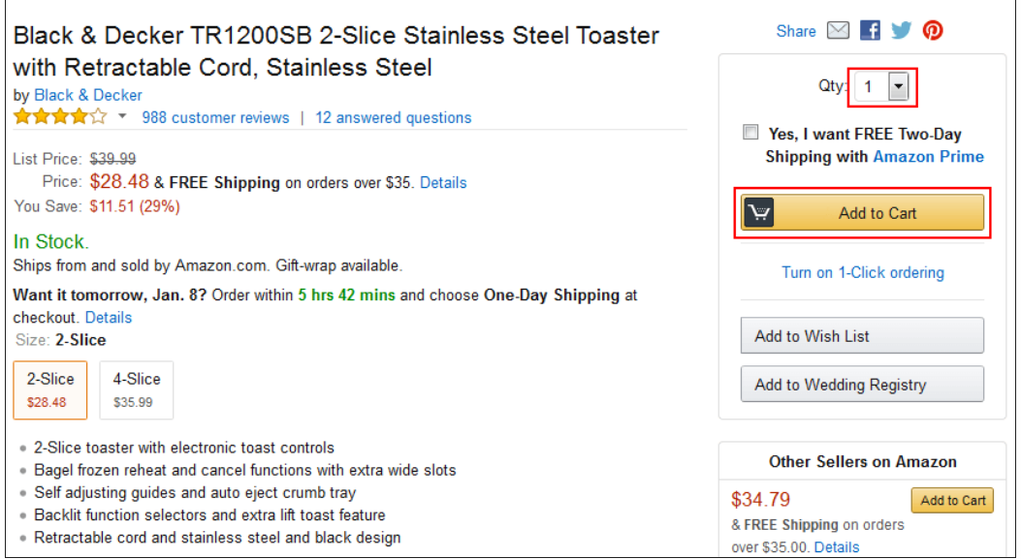
5. Add the item to your cart.
Here, you’ll see some more detailed information about the product you’ve selected. If you’ve decided that it’s what you want, click the drop-down menu marked “QTY” to select how many of this product you want. Then click Add to Cart.

Slide 9
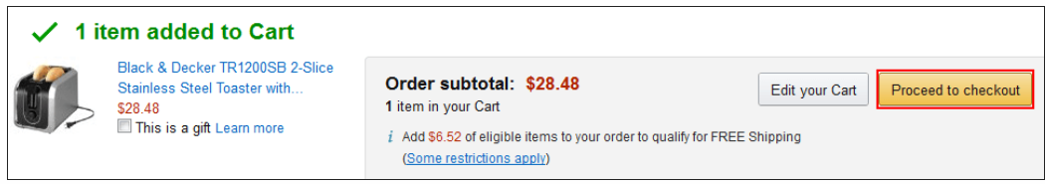
6. Proceed to the Amazon checkout.
If this is the only thing you want to buy, click Proceed to Checkout.

Slide 10
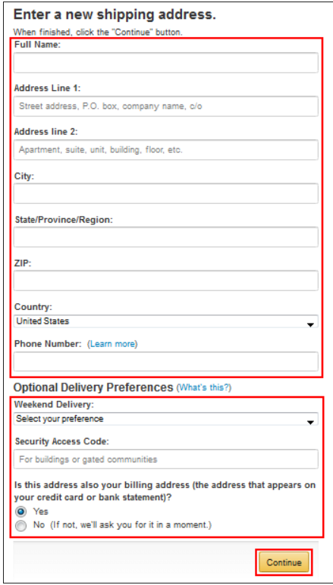
7. Enter a shipping address.
You’ll now have to pick an address to send your delivery to. If you don’t have one, you’ll have to create a new one.

Slide 11
Click in each of the boxes or drop-down menus underneath “Enter A New Shipping Address” and type in or select:
your full name
your street address
your unit address (if you live in an apartment, condo, etc.)
the city in which you live
the state, province, or region in which you live
your mailing code (doesn’t have to be a U.S. Z.I.P. code)
the country in which you live
your phone number
There are additional options underneath “Optional Delivery Preferences”, where you can:
choose whether or not you’re available on weekends to receive delivered packages
provide Amazon with the access code to your apartment complex or gated community (if you’re allowed) so a delivery person can get in
choose whether or not the address your items will be shipped to is the same one that you want your bill to come to
When you’ve entered all of your information, click Continue to move on.

Slide 12
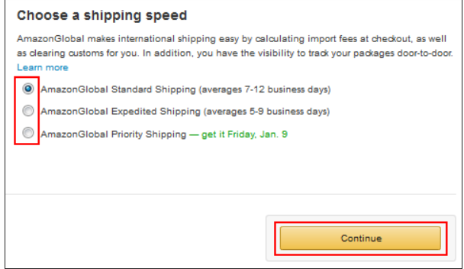
8. View and confirm your order summary.
On the left, you’ll see your order summary. On the right, you’ll be asked to select what kind of shipping you want (if applicable). Click the button next to the type you want. Usually, the faster the shipping speed, the more it will cost you. When you’re done.

Slide 13
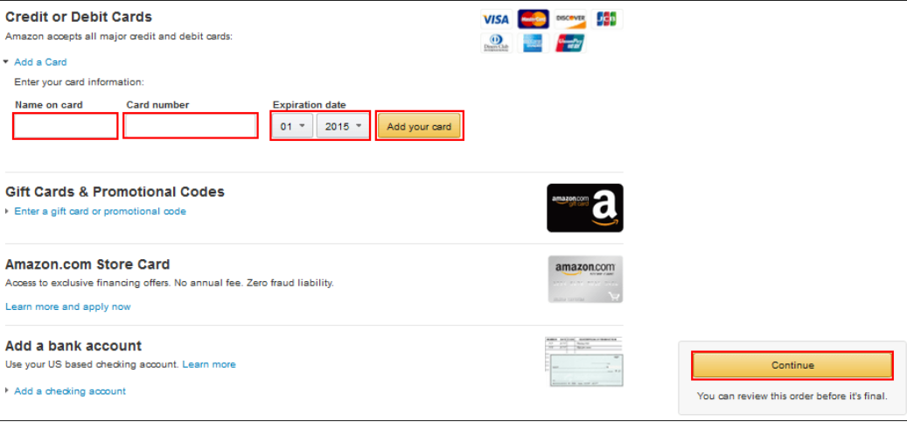
9. Choose a payment method.
You’ll now have to select a method of paying for your purchase.

Slide 14
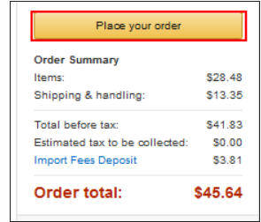
10. Confirm and place your order.
On the next screen, you can review your order and make any final changes, including the type of shipping you want. If you’re happy with what you have, click Place Your Order.

Slide 15
Positive Test Cases
Enter Valid Username.
Enter Valid Password.
Click on “Forgot Password” Link and find out forgot password page.
Click on Create new account button and verify if it takes to new account page.
Select “Keep me signed in” option to retain login session.

Slide 16
Negative Test Cases
Enter invalid username and valid password.
Enter valid username and invalid password.
Enter invalid username and password.
Keep one field blank either username or password and check login.

Slide 17
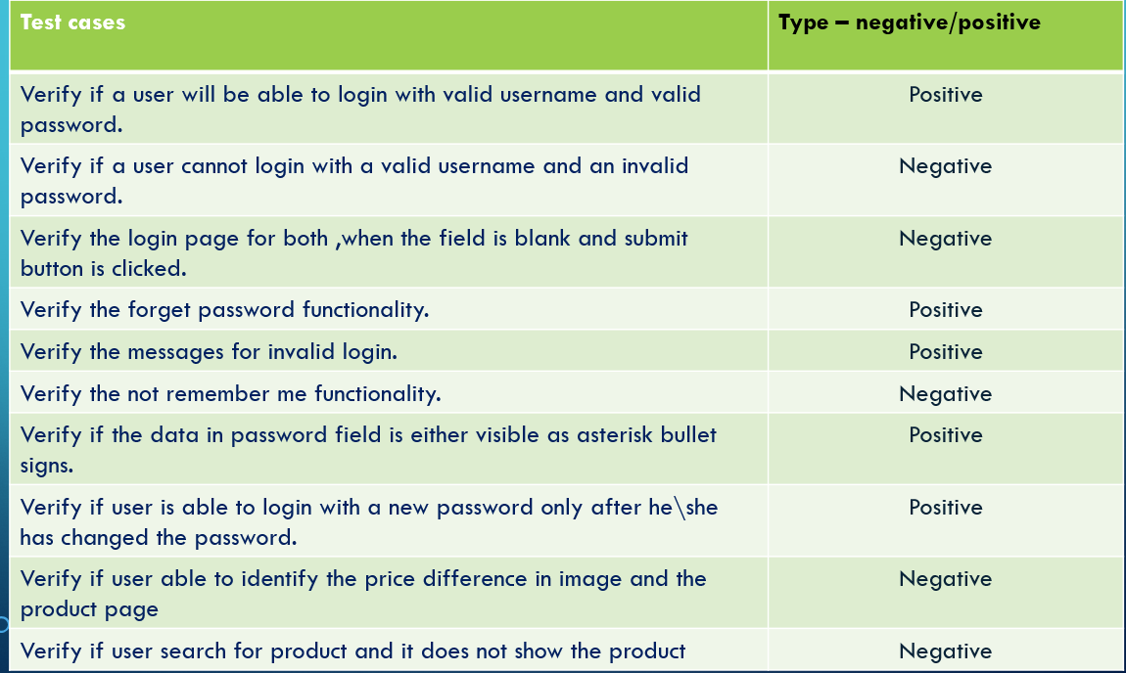
TEST CASES

Slide 18
Conclusion
It can be said that Amazon is the face of the current market global, digital, and constantly expanding. It is an increasingly productive brand, which adapts quickly to new demands, in a fast, effective and original way. For this reason, for now, even though it faces competition on all its fronts, individually, its corporate umbrella remains unparalleled and, therefore, must remain in the lead, for years to come.

Slide 19

DILIP KUMAR.R
192011064

